Slide 1
Gradual Release
Master Degree in Computer Science, ICT Solutions Architect curriculum
Security Methods and Verification
Unifying declassification, encryption and key release policies
Giulio Purgatorio - 516292
Notes:
https://ieeexplore.ieee.org/document/4223226

Slide 2
Information Security
Information Flow
“Information flow in an information theoretical context is the transfer of information from a variable x to a variable y in a given process” (Wikipedia)
The goal is to provide security assurance via restricting the information flow within the system.
But in some cases, flows may be necessary…
Notes:
Information Flow: Not all flows may be desirable; for example, a system should not leak any secret (partially or not) to public observers.

Slide 3
Declassification policies
Revelation-based
Encryption-based
“A revelation policy Reveal(e1, . . . , en) says that an observer may learn the value of any and all of the input expressions e1 to en. For example, policy Reveal(H[0]) states that an observer of the program may learn everything about the most recent input on channel H. This policy is an accurate description of the information flow of the following program, for an observer of the output of channel L.”
A standard encryption, depending on a secret key: it must not be released until necessary.
Furthermore, there are many dimensions of declassification: WHAT, WHO, WHERE and WHEN.

Slide 4
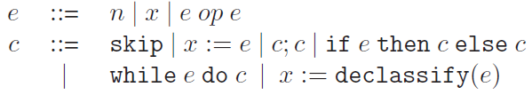
Gradual Release
The first framework to unify revelation-based and encryption-based declassification policies.
Of particular interest are language-based instantiations of this model
Security lattice
recorded in the security environment Γ
Notes:
Where policy: because it emphasizes that release is only allowed via declassification points.
Language: we assume that variables are assigned one of the two security levels: L (low) or H (high), forming a simple security lattice, where L < H. Declassify(e) in an assignment is provided for declassifying the level of e to L.
Security Environment: a mapping from variable names to security levels

Slide 5



Introducing Gradual Release
Low-Equivalence
Two memories M1, M2 are low-equivalent with respect to a security environment Γ if:
∀x . Γ(x) in L ⇒ M₁(x) = M₂(x). This is denoted as M₁ ∼_{Γ} M₂.
Semantics
Expression Evaluation: M memory, e expression to evaluate, n resulting value
Transitions between configurations.
Termination: a particular transition in memory M’
Declassify commands
A particular kind of low events, referred as release events.
Notes:
Memories are mapping of variable names to values.
A transition is low if it is due to an assignment to a low variable or termination.
We classify the Termination event as low. If an event in a sequence is a termination event, then no other events may be generated after it.
Release events record the points of intentional information release by a command.

Slide 6
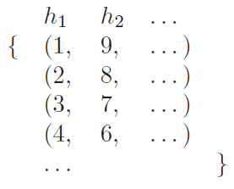
An attacker’s knowledge about the initial memory is defined as the low projection M⁰_{L} of the initial memory M⁰ and all intermediate low events l₁, …, l_{n} generated during a run of a command c.
Example
Consider x := h₁ + h₂ and a sample run that yields a low event l where l(x) = 10.
Then the attacker’s knowledge in this case is all memories such that the sum is 10, like:
Notes:
Knowledge: the attacker may infer the set of initial memories that could possibly have led to these events.
Example: Semantically, the knowledge is a set of tuples where each tuple represents a possible initial memory.
So, the actual initial knowledge of the attacker is that tuples outside of the knowledge set are not possible inputs!

Slide 7

Knowledge set may shrink with time!
L(c, M⁰_{L} ) the set of possible low event sequences that a program c may generate along terminating traces that start in some memory whose low projection is M⁰_{L}
_{So we define}
Knowledge:
Initial knowledge:
Termination-insensitive version:
Notes:
Intro: As the computation progresses, the uncertainty might decrease because new observations might render some initial inputs impossible.
Define Knowledge: this set records all possible inputs that lead to observing l^{->} when starting with initial memories that agree with M⁰_{L} on the low variables. It’s Termination-Sensitive because observing that the program does not enter an infinite loop may lead to refining the knowledge.
Initial knowledge: corresponds to all possible initial memories that lead to termination

Slide 8
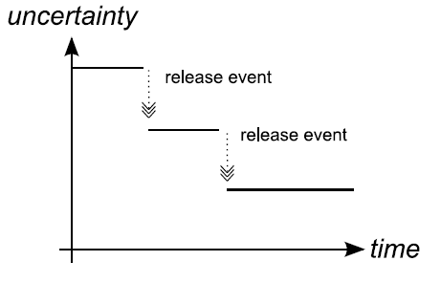
With every new low event produced by a program run, the attacker’s knowledge may become more precise. These points are the release events.
Formally..
Monotonicity of knowledge
Non-interference
A command c satisfies noninterference if and only if
Notes:
I.e. the set of possible initial memories may become smaller.
[So, we are letting information flow in some cases as requested]
Monotonicity: for a command c, some M⁰_{L} , and l_{n} = l₁, …, l_{n} the knowledge is contained in the next step.
Figure 2: shows the evolution of knowledge.
Non-interference: when starting with low-equiv memories, terminating traces must agree on their low events. So there’s the absence of flows from high to low data!
[knowledge-based]: all memories that agree with M⁰_{L} on the low part are possible inputs regardless of the observed low events l^{->} [knowledge doesn’t benefit from observing a run of a noninterfering program]

Slide 9



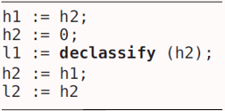

Assuming l* to be low and h* to be high
Rejected examples
Accepted examples
Special cases that are positively handled
Notes:
R.1) The knowledge is narrowed down from all possible high inputs to exactly one
R.2) Where the knowledge is narrowed down to memories where h is zero in the case when no low events are observable before termination
A.1) where the release event due to declassification justifies the change in the knowledge.
A.2) where the non-zero test expression is explicitly released before the choice whether to declassify h1 is made.
S.1) a what policy would accept it. At step 3, atker learns nothing about h2. But after reaching step 5, the atkr’s knowledge will allow inferring the value h2. It’s rejected by GradRel because step 5 isn’t a declassification!
S.2) Many where definitions rely on state resetting in-between transitions. They usually reject this program because resetting the secret state after declassification may introduce secret into h before it is assigned to l. However the program is secure according to GradRel because the atkr doesn’t gain any new knowledge from last assignment!

Slide 10
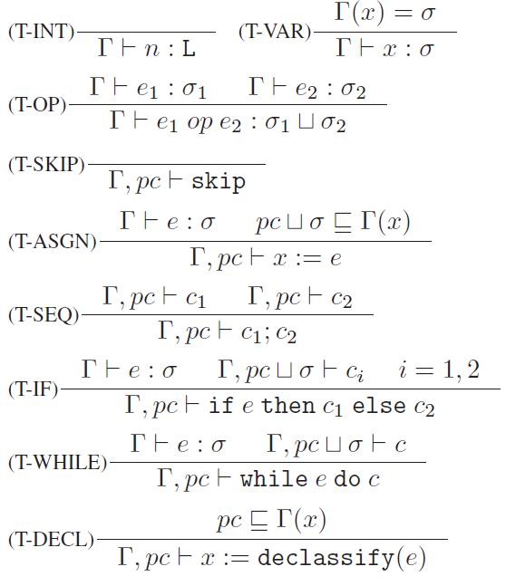
Enforcement (by a security type system)
Standard typing rules
Non-standard rule: it disallows declassification inside high context loop/conditionals.
Notes:
[Typing rules: for catching implicit and explicit flows]
High context: when there are sensitive guards, we track it with the context type variable pc. By requiring that it’s in Gamma at declassification points, we ensure that if pc is H then we might be inside a high context -> can’t assign the
result of declassification to a variable at level L. Note: no information about e’s value, WHERE policy!

Slide 11
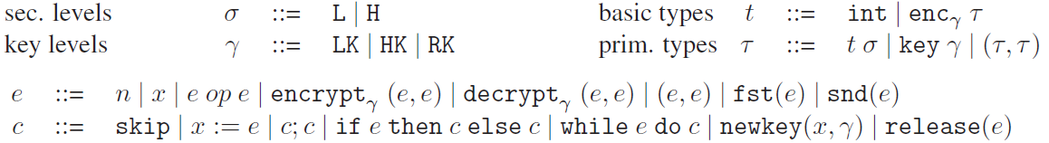

Enriching the previous language
by including cryptographic primitives and key release features.
Semantics [1]
Two different schemes (one for LK, one for HK) represented by triples
This allows us to define the full environment as a tuple (M, G, R)
Notes:
Values and keys have corresponding security levels.
Values are either Low or High.
Key levels declare the max security lvl that the key can safely encrypt (High can encrypt low and high, Low only low)
Keys at level RK correspond to previously released secret keys. They can be used to safely encrypt public values.
Basic types are int and ciphertexts obtained by primitive types with keys at level gamma
Primitive types are basic types labeled with security levels t sigma, key types gamma, pairs of primitive types.
Semantics
K is a key generation algorithm that on each invocation generates a new key.
E is a nondeterministic encryption algorithm that takes a key and a value -> returns a cyphertext.
D is a deterministic decryptino algorithm that takes a key and ciphertext -> value or fails.
Two different schemes because of extensibility! Each schema -> one security level
M memory environment: mapping from variable names to values
G key-stream environment: mapping from key levels to streams that generate fresh keys.
R released-key environment: a set of released key

Slide 12
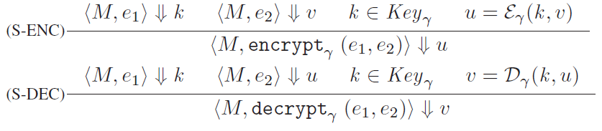
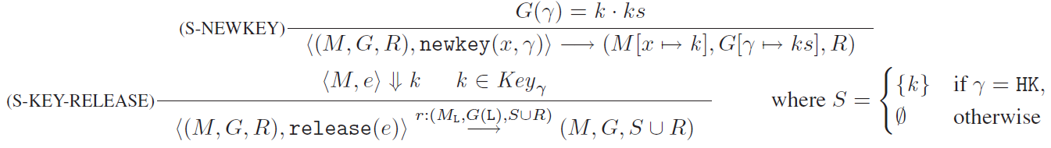
Semantics [2]
… for expressions
… for commands
Notes:
Expressions: have the form of the usual expression evaluation <M, e> ⇓ v. [Other rules in papers]
Commands: Similarly again, <E,c> -alpha-> <E’, c’> where E/c are initial&resulting environment/command.
S-NEWKEY takes a variable name and a level of the key to be generated and assigns the topmost element in the key stream associated to that level in the key-stream environment to the variable.
S-KEY-RELEASE generates a release event and updates the set of released keys R in the environment.
[The key-release command updates the set of released keys with the value of the key k, if k is High]

Slide 13


Gradual Release for the enriched language
Introducing an initial-vector in εγ, we define that two ciphertexts are low-related if:
Low-equivalence on event sequences
If encrypt_{HK}(k₁,(x,k₂)) and then releasing k₁, k₂ isn’t added to R
So we start with (M, G, ∅) and define the set of possible low events as:
... which defines the attacker’s knowledge as:
Notes:
Low-related: so for the same key and plaintext, the encryption algorithm (K, E, D) returns different ciphertexts depending on the value of the initial vector. This prevents occlusion (if we treated all ciphertexts as equal)
Low-equivalence: R represents a partial view of what keys may be known.
So we traverse low events and accumulate keys that depend on others, with an accumulator function.

Slide 14
Definition of Gradual Release
A command c satisfies gradual release if for all low projections of initial environments E⁰_{L} such that R⁰ = ∅ and sequences of low events l ∈ L(c, E⁰_{L} ), where l_{n} = (l₁, …, l_{n}), n ≥ 1, of which l_{r1}, …, l_{rn} are all release events, we have:

Slide 15


Simple examples
Accepted
Rejected
Accepted
Note that if there are no key releases, then the attacker’s knowledge must and will stay unchanged throughout the execution. Consider the following example:
Notes:
A.1) different low-event sequences that can be produced by this program correspond to different values of the variable l. Since the encryption key is High, every value of l is low-equivalent to ciphertexts produced by all other possible keys and plaintexts. Therefore the knowledge contains all possible keys and plaintexts, so it’s equal to the initial knowledge and remains constant throughout all runs.
R.1) the last assignment narrows down the set of possible initial values for the variable h to exactly one.
A.2) 4 low events in this program: encryption, release statement, last assignment, termination. Publishing the result of encryption doesn’t change knowledge. The release statement triggers a change in the low-equivalence for the value of l: once k is released, it’s only related with ciphertexts that agree with l both on the value of the key and the plaintext == refine the knowledge to the exact values of k and h. So the last assignment doesn’t make the knowledge more precise. [accepted because the only point where the knowledge changes is the release event!]
Example: intuitively insecure, depending on h, y is either a new encryption or the copy of x. Attacker may derive which branch has been taken! But thanks to the initial-vector mechanism, the program is rejected.
[Consider an initial memory M where h = 1: it produces a sequence of low events where the final values of x and y are respecively v_{x} =/= v_{y}. In M’ (h = 0, not part of the knowledge) I can produce a low-event sequence where v = vx, but then v =/= vy, so M’ isn’t part of our knowledge]

Slide 16
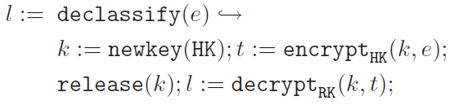
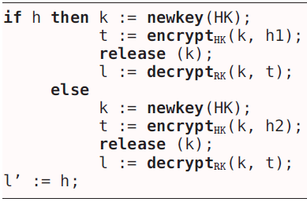

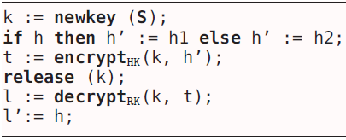
So we can connect the encryption-based declassification and revelation-based one in the following way:
Practical example
Semantically equivalent to..
The transformation produces in the enriched language
Notes:
Example: GradRel will reject this since the last assignment leaks the exact value of the variable h that is unknown to the attacker otherwise.

Slide 17
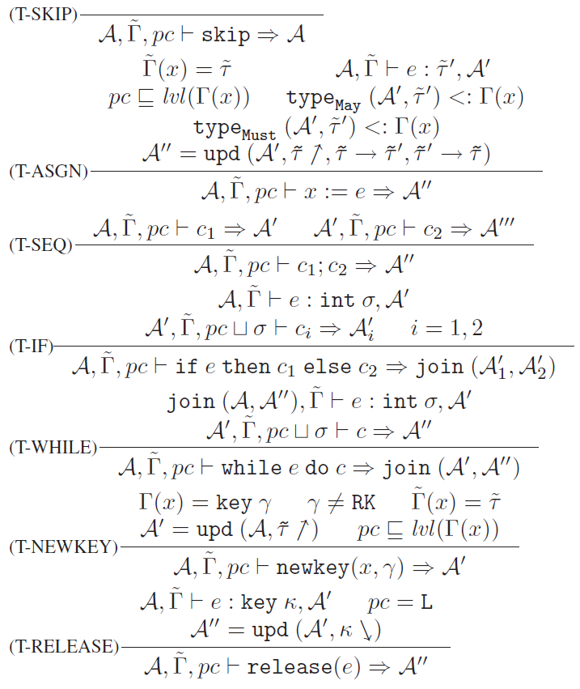
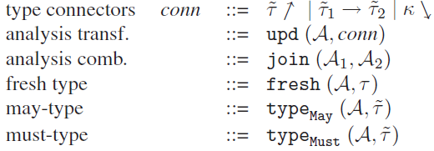
Last enforcement step:
Dependency analysis
A denotes a key dependency relation. A’s interface is defined by the following syntax
A enforces E
A,˜Γ |= E,
Notes:
Intro: through a type and effect system we can enforce the dependency analysis, so that the type system can be aware of the key names that may or must have been released at every program point. Key Names must be unique, easily obtained by enumerating them.
1 marks t as unrelated to any other type
2 indicates that if 1° is released, then 2° is released as well.
3 specifies that k is released
Join combinaes the information from A1 and A2
Fresh takes a dependency relation and a primitive type and returns an extended type [enumerated] with the same structure as t, but key names in it are fresh.
Through typeMAY and typeMUST we can obtain the results of the analysis.
A enforces E if for all key names that occur in ˜Γ:
1) if the analysis returns that a key name may not have been released, then key values in the memory environment associated with that name aren’t in the set of all released keys
2) if the analysis returns that a key name must have been released, then key values in the memory environment associated with that name are in the set of all released keys.

Slide 18
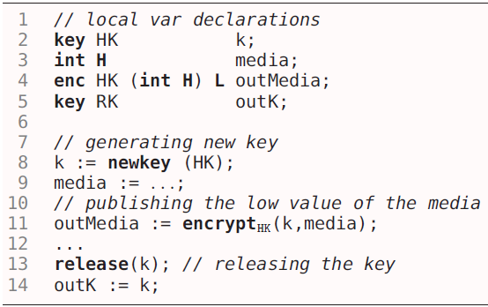
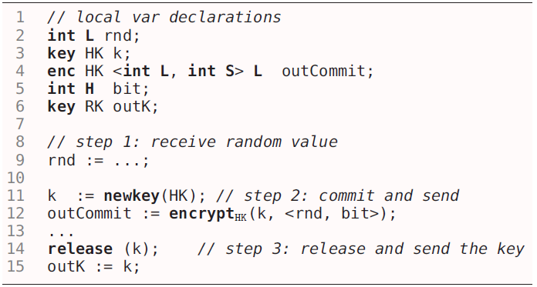
Media distribution
Bit Commitment
Mental Poker
Notes:
Media Distribution: Large media is distributed in encrypted form prior to the official release date. On that date, secret keys are supplied to the costumer.
Mental Poker: Similar to Media distribution, encrypting during the game corresponds to card shuffling without a trusted third party. At the end of the game, there is a verification phase to verify that no player was cheating.
Bit Commitment: A common building block in security protocols. Using symmetric cryptography between two principals, one of the two commits its bid by encrypting (with a fresh key, later revealed) a tuple consisting of the bid and a random value obtained from the other principal.

Slide 19
Conclusions
Benefits
Future Work
Policy-perimeter defense
Connection between revelation-based and encryption-based declassification
Conservativity
Type-based enforcement
Integrate the WHAT dimension
Consider actors that run concurrently and interact with each other
Notes:
Benefits
1) The first framework to provide assurance for policies that include all of declassification, encryption and key release.
2) gradualRelease for revelation-based declassification can be represented by a simple encryption-based declassification. Declassifying an expressions corresponds to encrypting the expression with a fresh key and immediately releasing the key.
3) If there’s no declassification or encryption, GradRel is equivalent to a form of noninterference. [No key release, possibilistic noninterference]
4) As we’ve seen earlier, gradRel can be enforced by type systems
Future Work
1) By connecting each release point to a poliicy that regulates what can be leaked.
2) In presence of key release, it’s not sufficient to view actors independently because a key release by one actor may affect others. So reason about whole-system security.

Slide 20


